Slide 1
Class 10
Policies and Institutions: National, Other by
Alan V. Deardorff
University of Michigan
2021
PubPol/Econ 541

Slide 2


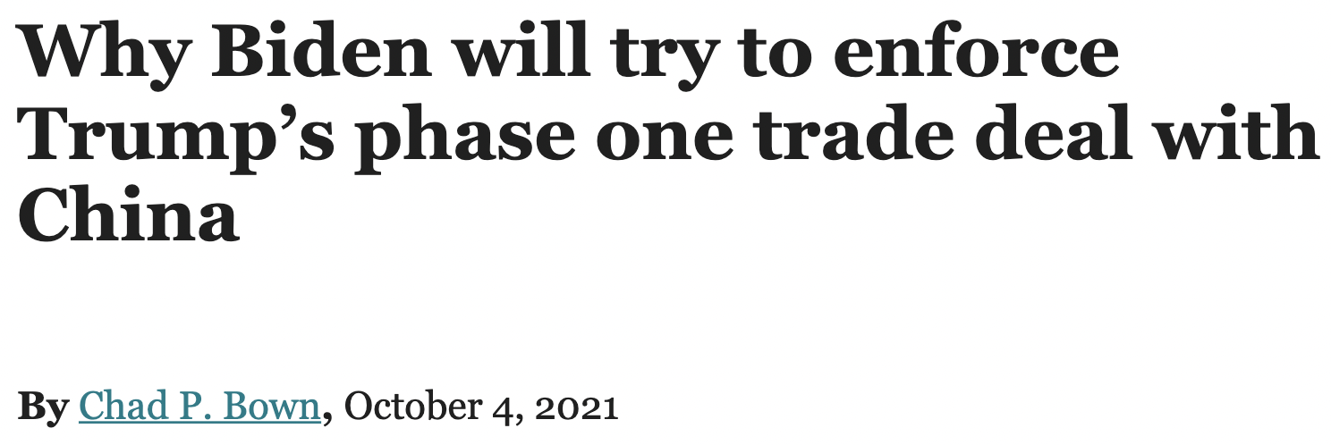
Notes:
https://www.piie.com/blogs/trade-and-investment-policy-watch/why-biden-will-try-enforce-trumps-phase-one-trade-deal-china

Slide 3
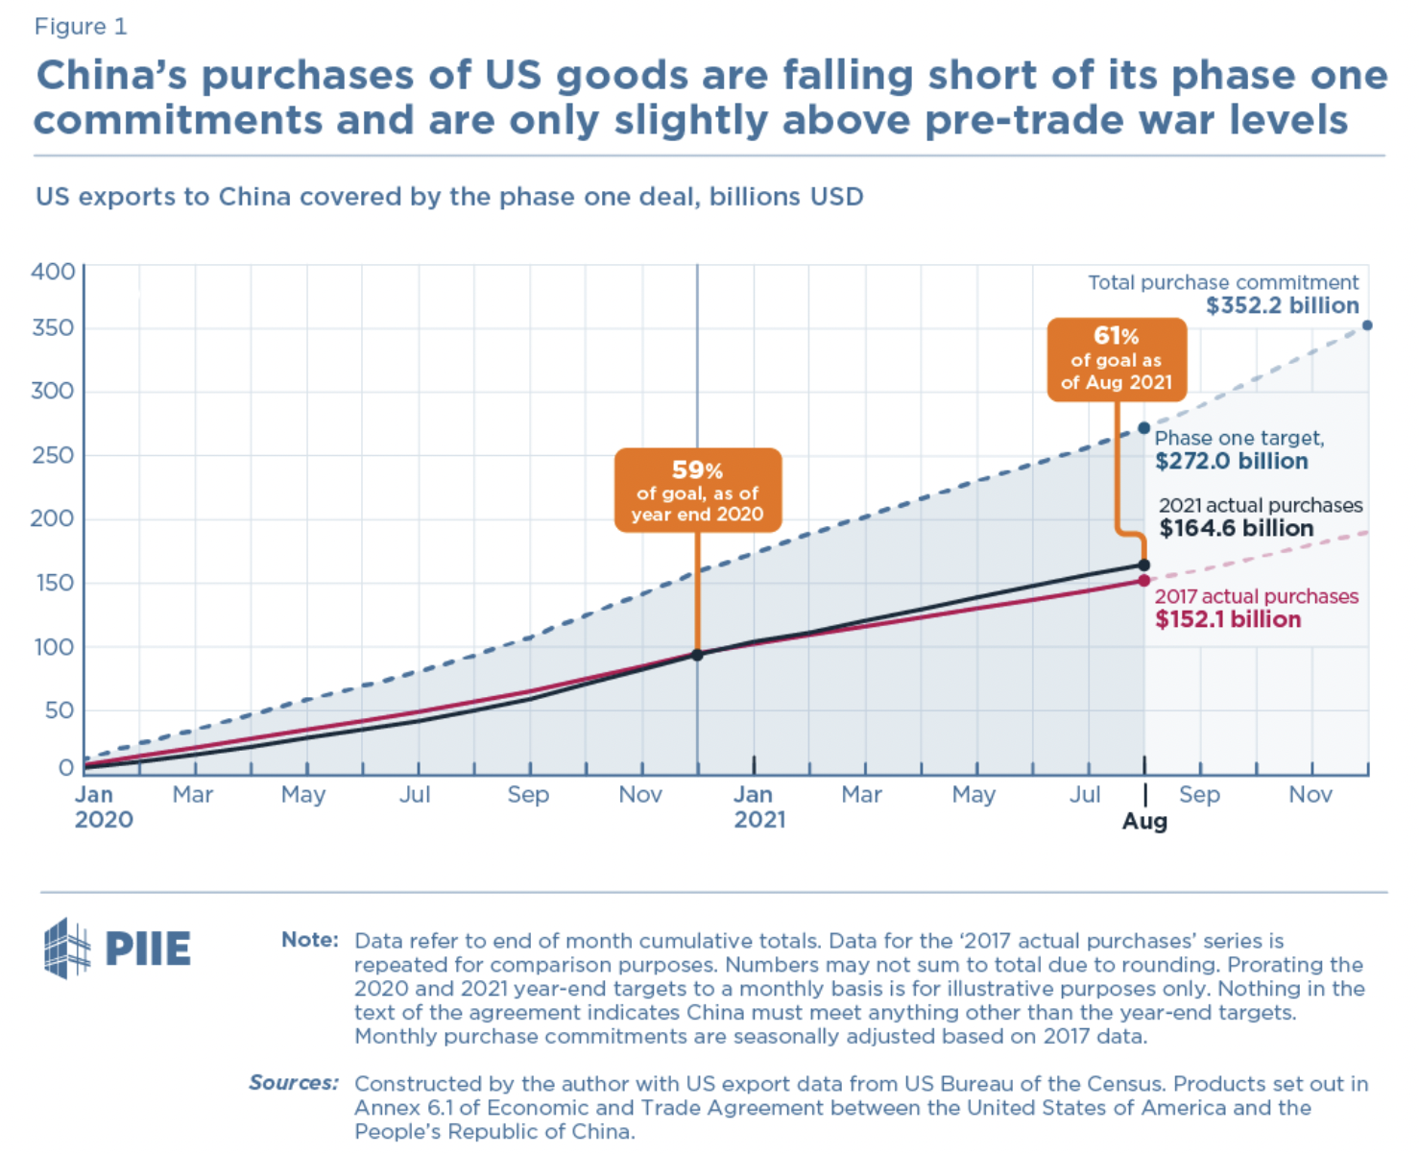

Slide 4
Announcement
Quizzes
  Results:
 | Q1 | Q2 | Q3 | Q4
Mean | 8.97 | 7.21 | 6.50 | 8.66
Median | 9 | 7.5 | 6.5 | 9
Max | 10 | 9.5 | 9.5 | 10
Min | 6.5 | 4 | 4 | 5
S.D. | 1.09 | 1.70 | 1.72 | 1.31

Slide 5
Outline
European Union
Japan
China
Other

Slide 6
European Union
History
  1957 Treaty of Rome created European Economics Community (EEC) as a ”common market”
    Eliminated barriers to movement of goods, services, capital, and labor (eventually)
    Prohibited policies to inhibit market competition
    Adopted Common Agricultural Policy (CAP)
    Adopted common external trade policy
      (Hence a Customs Union)
  Original Six countries: Belgium, France, Germany, Italy, Luxembourg, Netherlands
  Added 6 more: 1973: Denmark, Ireland, UK; 1981: Greece; 1986: Portugal, Spain (also E. Germany 1990)
Notes:
Gabel, Matthew J., “European Union,” Encyclopedia Britanica, 2020.
https://www.britannica.com/topic/European-Union/The-Maastricht-Treaty

Slide 7
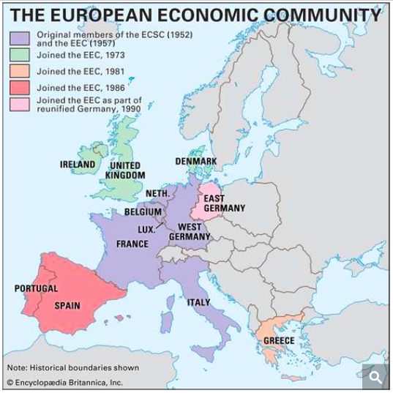
As of 1990
Notes:
Gabel, Matthew J., “European Union,” Encyclopedia Britanica, 2020.
https://www.britannica.com/topic/European-Union/The-Maastricht-Treaty

Slide 8
European Union
History
  “Europe 1992”: Treaty on European Union, signed Feb 7, 1992, in Maastricht, Netherlands
    “Four Freedoms” became reality: free movement of goods, services, people, and money
    Set rules for single currency
  1995: Added Austria, Finland, Sweden
  2004: Added 10 more: 8 from former Soviet Bloc, plus Malta and Cyprus
  2007: Added Bulgaria and Romania
  2013: Added Croatia
  2020: Subtracted United Kingdom
Notes:
Gabel, Matthew J., “European Union,” Encyclopedia Britanica, 2020.
https://www.britannica.com/topic/European-Union/The-Maastricht-Treaty

Slide 9
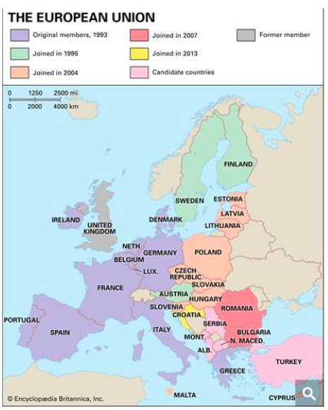
As of 2020
NOTE:
Not yet members, and maybe never:
Serbia
Montenegro
N. Macedonia
Albania
Turkey
Notes:
Gabel, Matthew J., “European Union,” Encyclopedia Britanica, 2020.
https://www.britannica.com/topic/European-Union/The-Maastricht-Treaty

Slide 10
European Union
The EU today
  27 Countries
  Note who is not in
    UK (anymore)
    Switzerland
    Norway
    Iceland
    Official candidates: Turkey and several parts of former Yugoslavia
    Potential candidates: Other parts of former Yugoslavia
Notes:
Gabel, Matthew J., “European Union,” Encyclopedia Britanica, 2020.
https://www.britannica.com/topic/European-Union/The-Maastricht-Treaty

Slide 11
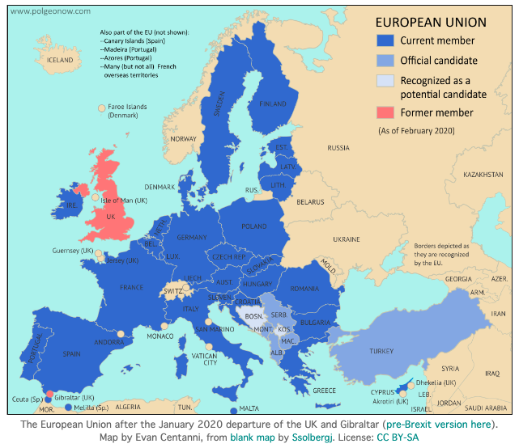
Notes:
https://www.polgeonow.com/2016/06/map-which-countries-are-in-the-eu.html

Slide 12
European Union
Two main institutions
  European Council
  European Commission
Notes:
Gabel, Matthew J., “European Union,” Encyclopedia Britanica, 2020.
https://www.britannica.com/topic/European-Union/The-Maastricht-Treaty

Slide 13

European Union
European Council
  Heads of national governments, expressing their national interests
  Presidency rotates among member states every six months
    Not a person, but a country. Currently Slovenia
  There is also a person with the title President of the European Council: Charles Michel
    Runs meetings
    Represents EU externally
Notes:
Gabel, Matthew J., “European Union,” Encyclopedia Britanica, 2020.
https://www.britannica.com/topic/European-Union/The-Maastricht-Treaty

Slide 14
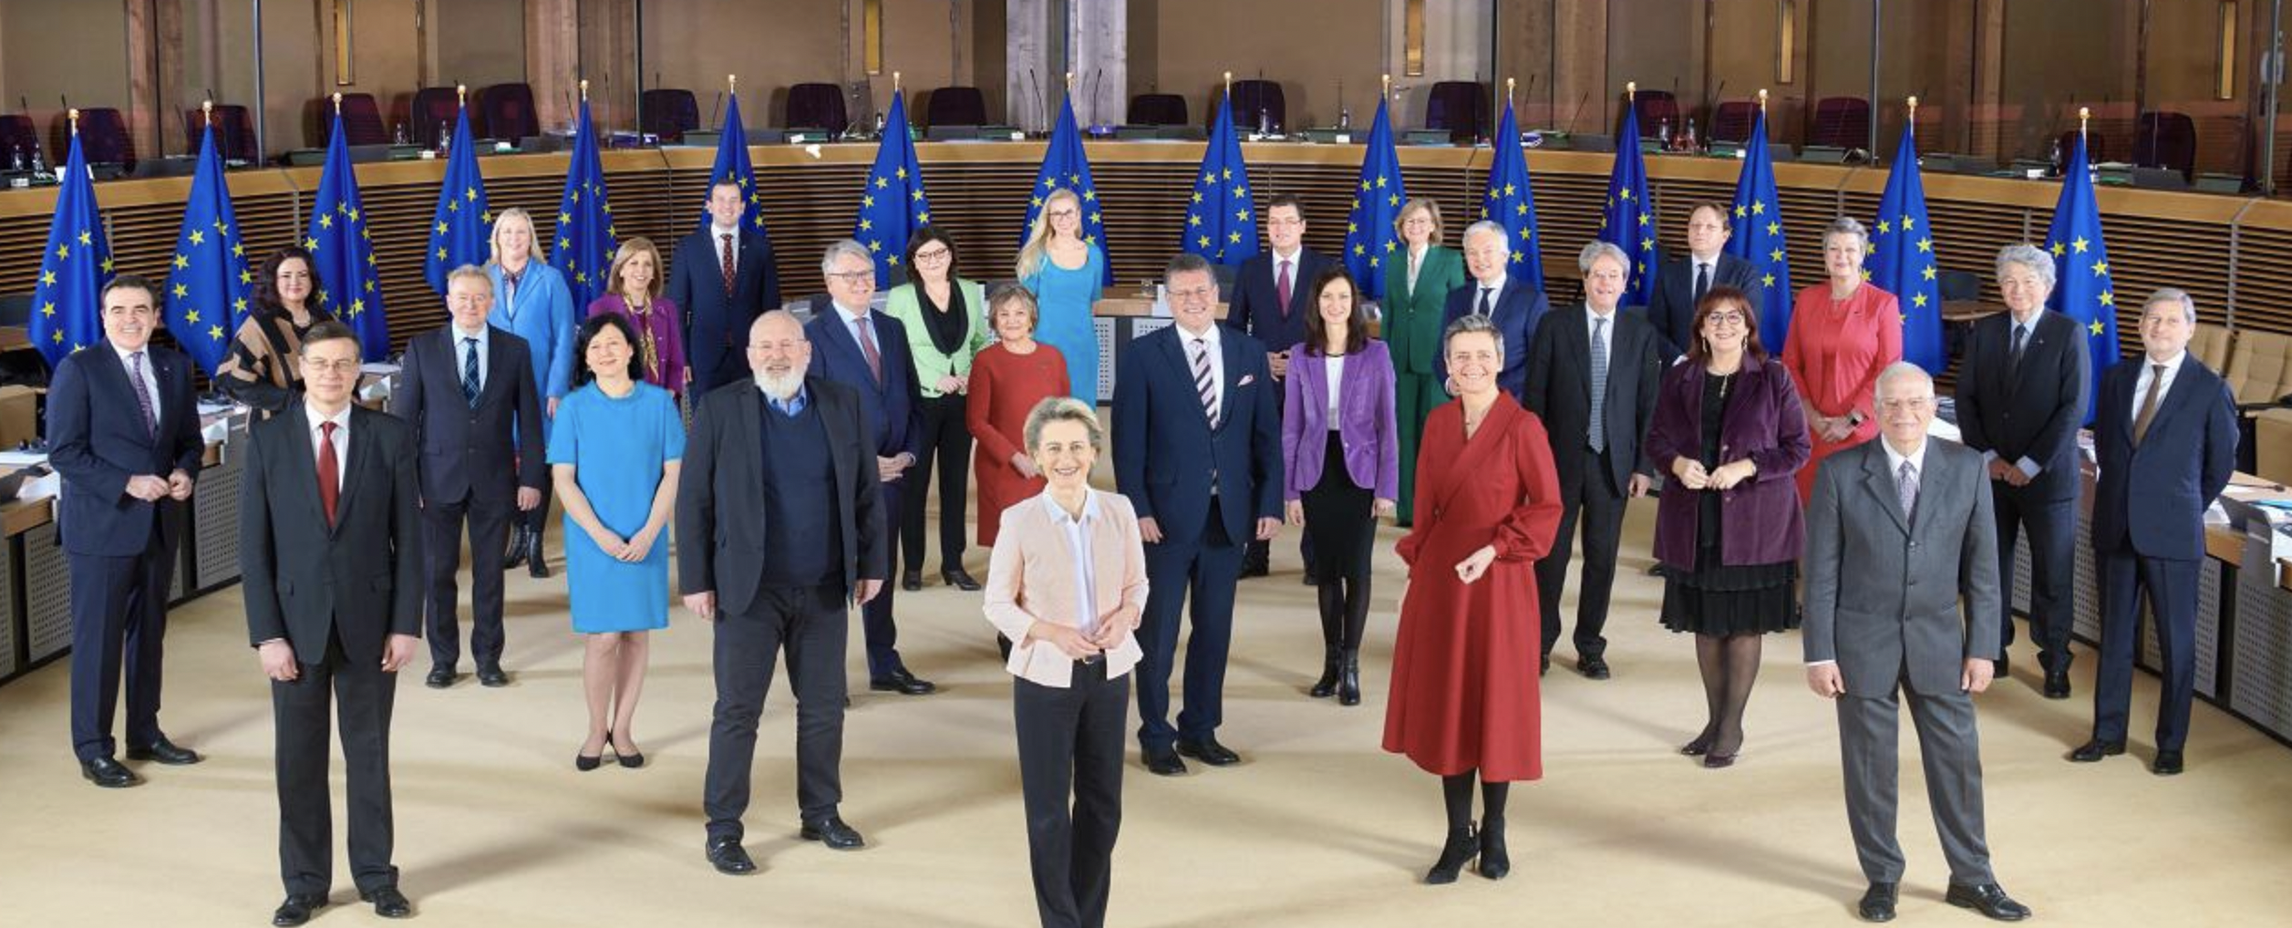
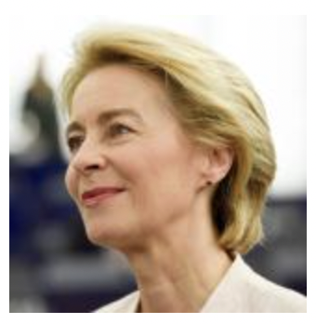
European Union
European Commission
  27 Commissioners, one from each member country
  Represents the whole of the EU, not the individual national interests
  Drafts legislation and handles day-to-day running of EU
  Current President is Ursula von der Leyen
Notes:
Gabel, Matthew J., “European Union,” Encyclopedia Britanica, 2020.
https://www.britannica.com/topic/European-Union/The-Maastricht-Treaty

Slide 15
European Union
Other institutions
  Council of the European Union
    Not the same as European Council
    National ministries, a Council for each area
  European Parliament
  Court of Justice
  European Central Bank
  Court of Auditors
Notes:
Gabel, Matthew J., “European Union,” Encyclopedia Britanica, 2020.
https://www.britannica.com/topic/European-Union/The-Maastricht-Treaty

Slide 16
European Union
How it functions
  Commission “proposes”
  Council “adopts”: seeks unanimity, but if not, it votes
    Proportional to population
    But with small countries over-represented
Notes:
Gabel, Matthew J., “European Union,” Encyclopedia Britanica, 2020.
https://www.britannica.com/topic/European-Union/The-Maastricht-Treaty

Slide 17
European Union
Features relevant for trade
  Common external tariff
    Countries therefore can not join FTAs on their own
  Value-added tax (VAT)
    Rebated on exports
  Common agricultural policy (CAP)
    System of subsidies and support programs for agriculture
    Variable levies
  Numerous (~42) FTAs with other countries & groups of countries, including with former colonies
    Banana War: US-EU dispute over EU preference for former colonies’ banana. US won case at WTO
  State aid for firms is prohibited (unlike US)
Notes:
Gabel, Matthew J., “European Union,” Encyclopedia Britanica, 2020.
https://www.britannica.com/topic/European-Union/The-Maastricht-Treaty

Slide 18
European Union
Tariffs and Trade Disputes
  The following 2 slides come from WTO, Member Information, downloaded 9/24/21
  Tariffs: I assume they are up to date, as of 9/24/21
  Disputes: These are the total numbers of disputes since 1995.
Notes:
Gabel, Matthew J., “European Union,” Encyclopedia Britanica, 2020.
https://www.britannica.com/topic/European-Union/The-Maastricht-Treaty

Slide 19
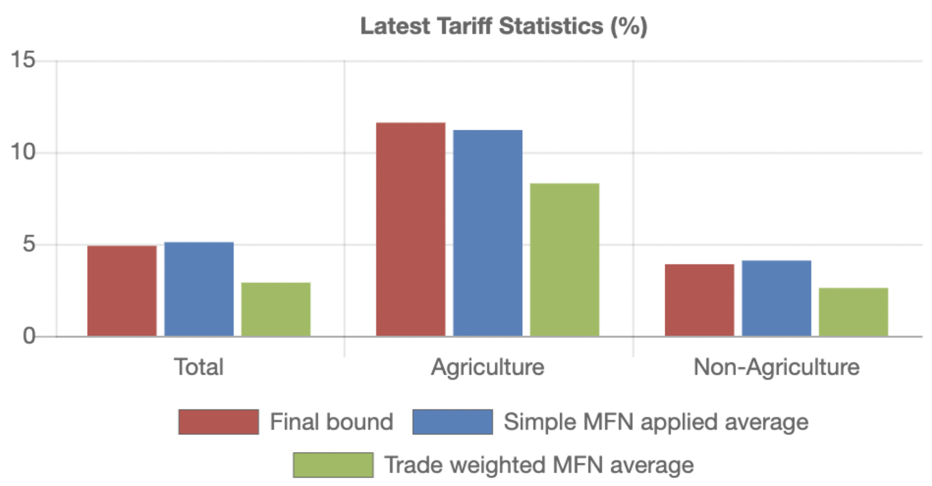
EU Tariffs per WTO
Notes:
https://www.wto.org/english/thewto_e/countries_e/european_communities_e.htm

Slide 20
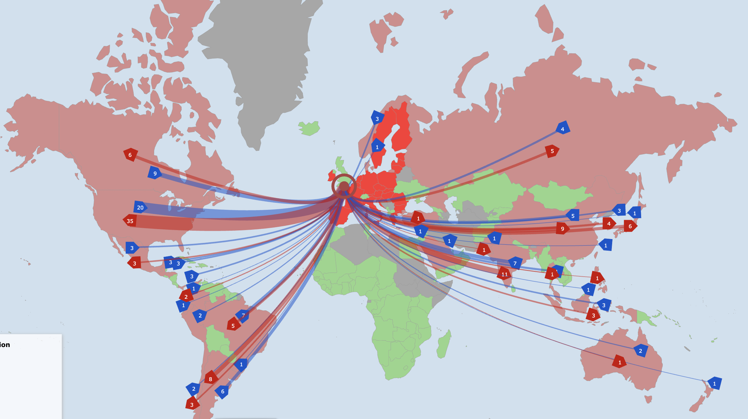
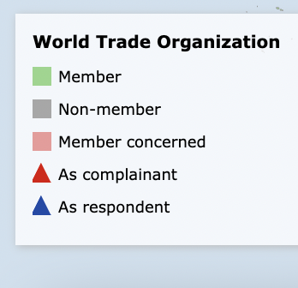
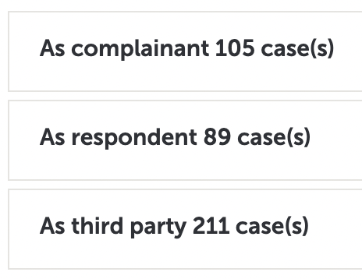
Disputes Involving EU
per WTO
Notes:
https://www.wto.org/english/tratop_e/dispu_e/dispu_maps_iframe_e.htm?country_selected=EEC&sense=e

Slide 21
Compare with US

Slide 22
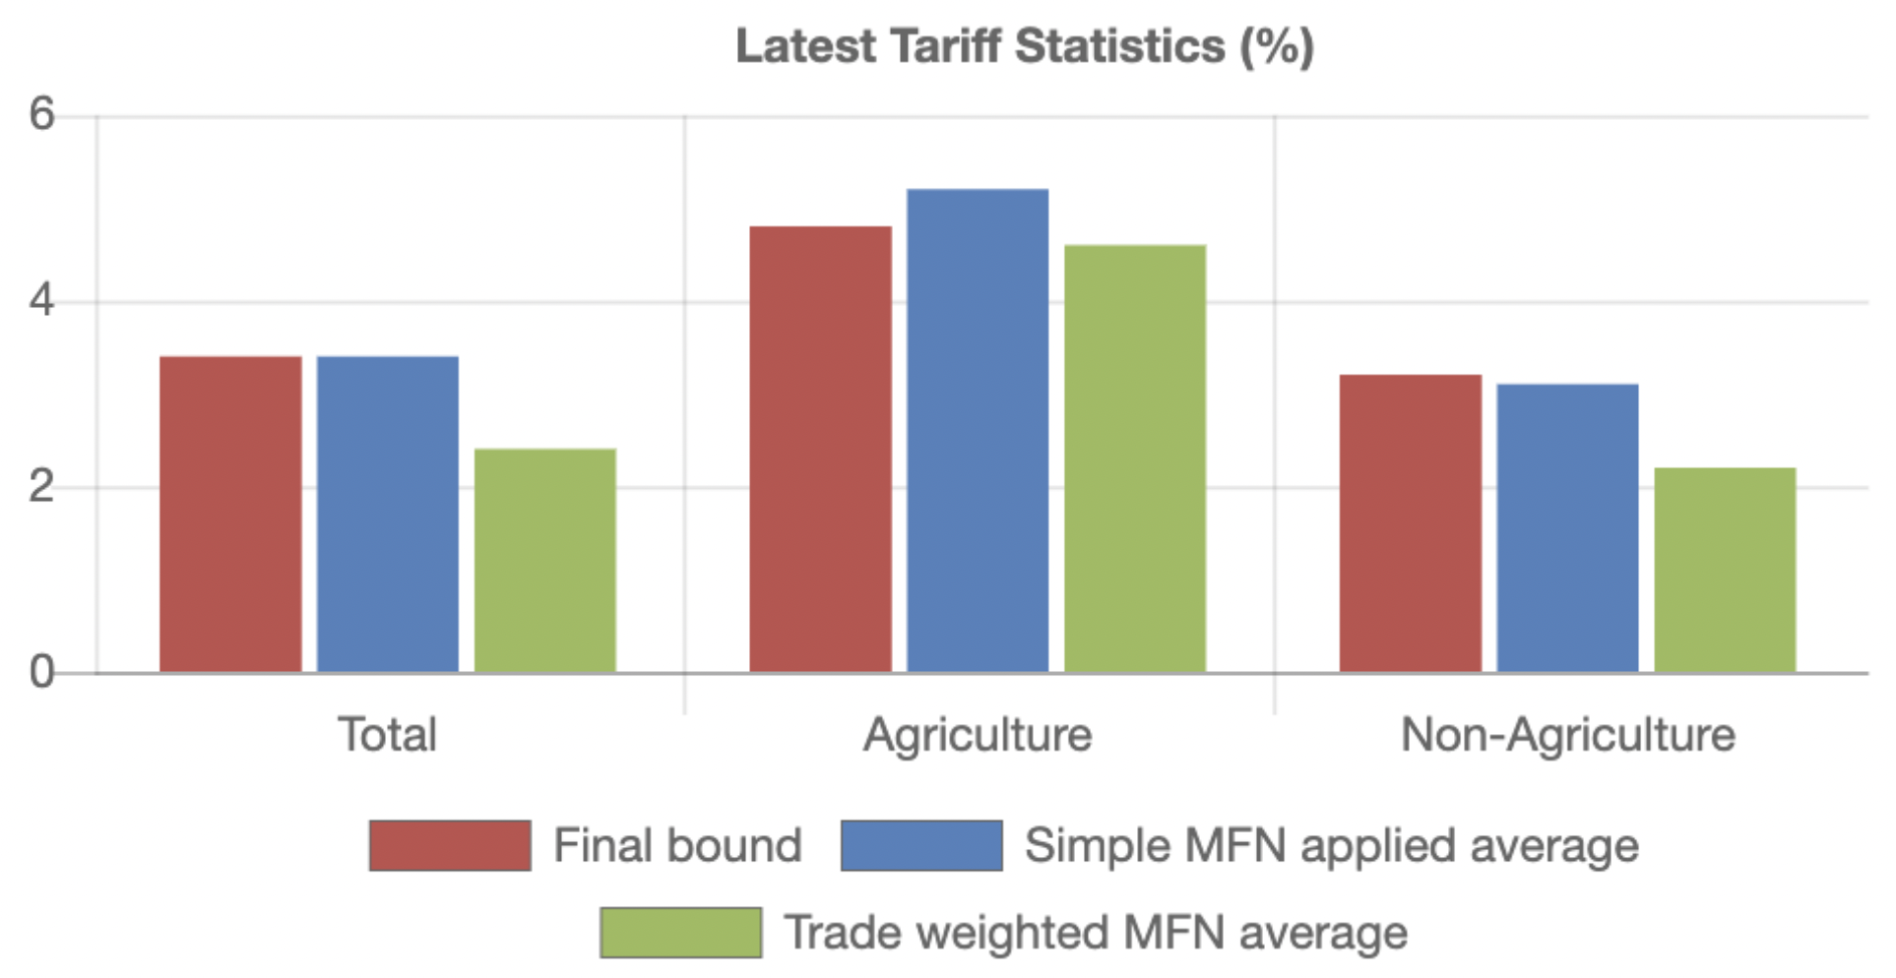
US Tariffs per WTO
Notes:
https://www.wto.org/english/thewto_e/countries_e/european_communities_e.htm

Slide 23
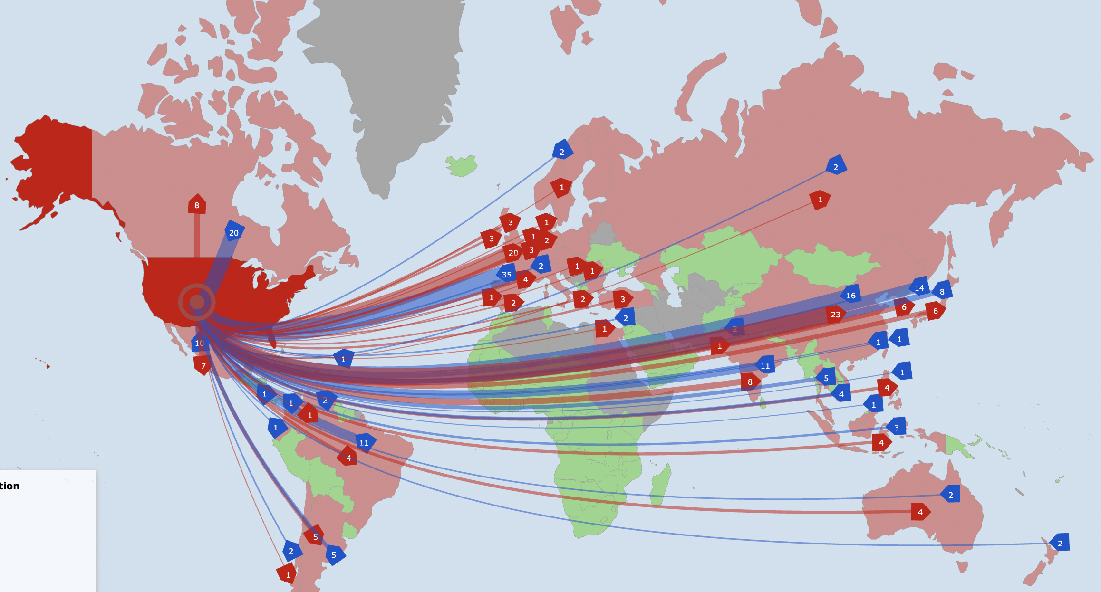
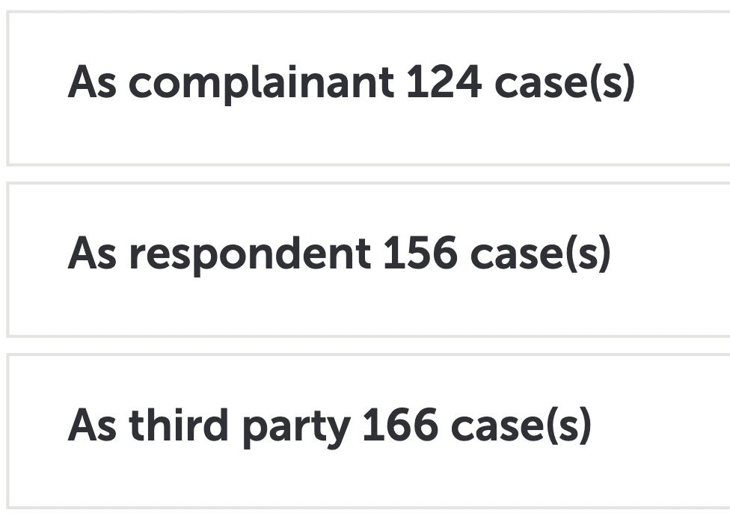
Disputes Involving US
per WTO
Notes:
https://www.wto.org/english/tratop_e/dispu_e/dispu_maps_iframe_e.htm?country_selected=EEC&sense=e

Slide 24
Comparison of EU with US
EU
US
These look comparable until you note the scales.
Notes:
Gabel, Matthew J., “European Union,” Encyclopedia Britanica, 2020.
https://www.britannica.com/topic/European-Union/The-Maastricht-Treaty

Slide 25
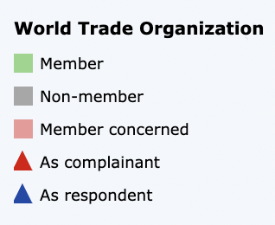
Comparison of EU with US
EU
US
Notes:
Gabel, Matthew J., “European Union,” Encyclopedia Britanica, 2020.
https://www.britannica.com/topic/European-Union/The-Maastricht-Treaty

Slide 26
European Union
Disputes at WTO in 2020-21: Respondent Complainant
  DS606: European Union — Provisional Anti-Dumping Duty on Mono-Ethylene Glycol from Saudi Arabia
    In consultations on 17 August 2021
  DS604: Russian Federation — Certain Measures Concerning Domestic and Foreign Products and Services, EU
    In consultations on 22 July 2021
  DS600: European Union and certain Member states — Certain measures concerning palm oil & biofuels, Malaysia
    Panel composed on 30 July 2021
  DS595: European Union — Safeguard Measures on Certain Steel Products, Turkey
    Panel composed on 30 September 2020
Notes:
Gabel, Matthew J., “European Union,” Encyclopedia Britanica, 2020.
https://www.britannica.com/topic/European-Union/The-Maastricht-Treaty

Slide 27
Pause for Discussion

Slide 28
  Questions
On Jackson:
What are the six entities that play constitutional roles in the European Community?
On “EU in Brief”:
What does the “single market” entail?
What are the three entities through which EU citizens and members states are represented?
Why and when did it change its name from EEC to EU?

Slide 29
  Questions on EC DG-Trade “Policy Making”
What sorts of policy are the “exclusive power of the EU,” meaning that they cannot be done by member states individually?
Which part of the EU negotiates trade agreements with other countries? Is that entity constrained in any way as to with whom it can negotiate and what its objectives should be?
Once a trade agreement is negotiated, who approves it?

Slide 30
  Questions on
  Pronczuk & Ewing
Who is the new European Commissioner for Trade, and what is his background?
Who does he replace, and why?
Is this position important?

Slide 31
  Questions on Economist,
  “The Trade War Within”
To what extent are EU countries largely free-traders?
Why was the EU considering taking some developing countries off the list for GSP treatment? Can you find out whether it did in fact do this for Brazil, Russia, Saudi Arabia, South Africa?
What are the 3 levels of EU GSP and what do they mean?
What is meant by the need for “reciprocity”?

Slide 32
Outline
European Union
Japan
China
Other

Slide 33
Japan
Portions of government dealing with trade
  METI = Ministry of Economy, Trade, and Industry
    Previously MITI, Ministry of International Trade and Industry
  MAFF = Ministry of Agriculture, Forestry, and Fisheries
    Handles all agriculture trade (with high tariffs)
  MOFA = Ministry of Foreign Affairs

Slide 34
Japan
Japan’s trade disputes
  Most serious recent dispute has been with South Korea
    2018: S.K. Supreme Court ordered reparations from 2 Japanese companies for WWII forced labor.
    S.K. also continues concerns about WWII “comfort women”
    2019: Japan tightened export controls to S.K. and dropped S.K. from its “white list” for ”fast-track exports”
    S.K cancelled military intelligence sharing
    2-way trade dropped 41%
    Foreign Ministers met 9/23/21, but have not yet resolved the issues.

Slide 35
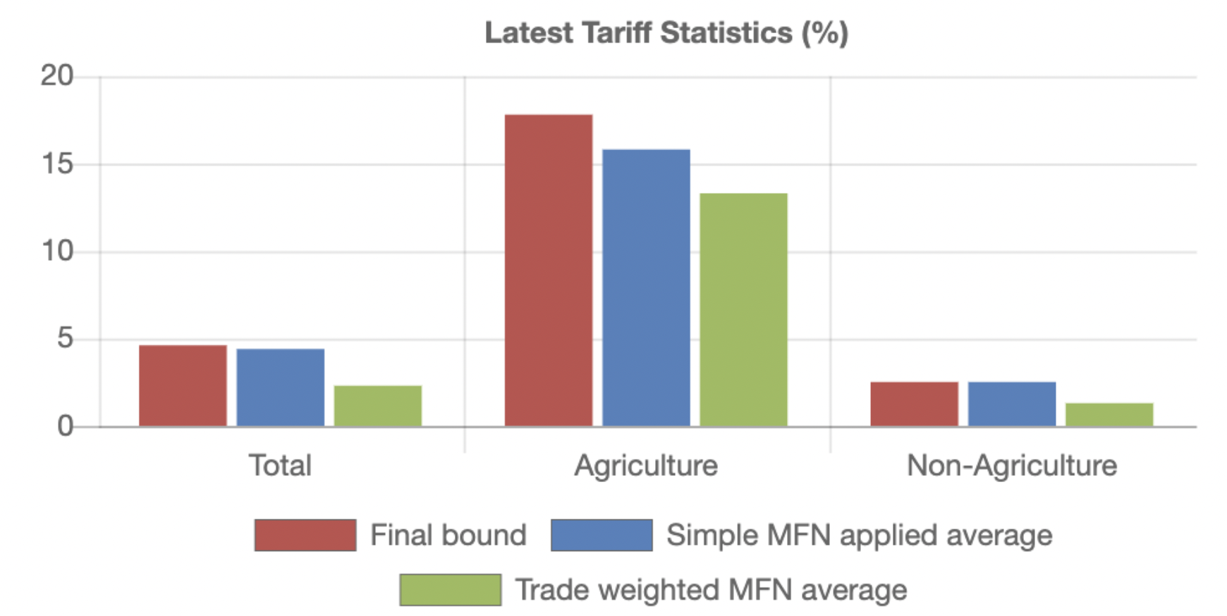
Japan Tariffs per WTO
Notes:
https://www.wto.org/english/thewto_e/countries_e/japan_e.htm

Slide 36
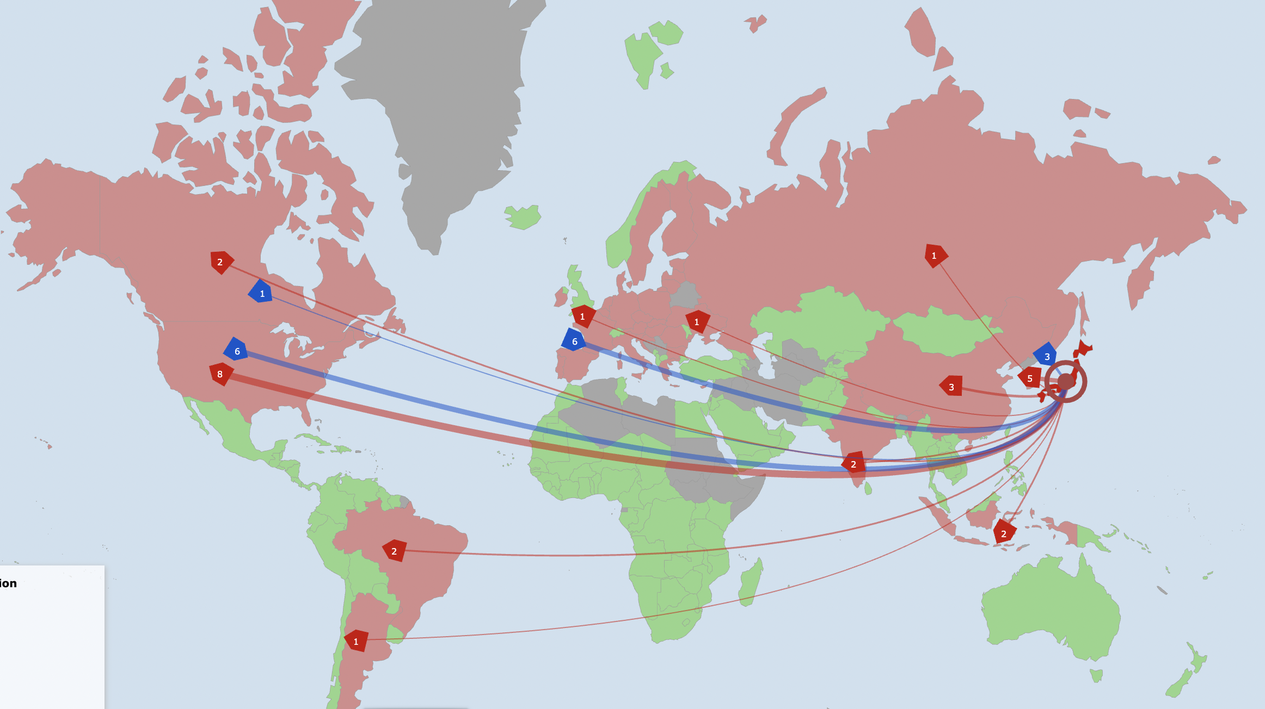
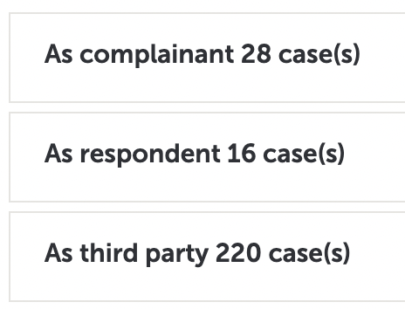
Disputes Involving Japan per WTO

Slide 37
Japan
Disputes at WTO in 2020-21: Respondent Complainant
  DS601: China — Anti-Dumping measures on stainless steel products from Japan
    In consultations on 11 June 2021
  DS594: Korea — Measures Affecting Trade in Commercial Vessels (second complaint) (Japan)
    In consultations on 31 January 2020
Notes:
Gabel, Matthew J., “European Union,” Encyclopedia Britanica, 2020.
https://www.britannica.com/topic/European-Union/The-Maastricht-Treaty

Slide 38
Pause for Discussion

Slide 39
  Questions
From Jackson:
Why is Japan a less complicated country than the US and EU for understanding its interaction with international trade law and negotiations?
From METI:
What is METI’s “general rule”?
What are some of the exceptions to free trade that they base their trade controls on?
What are some of the things that METI does?

Slide 40
  Questions on Japan’s
  “Trade Policy Review 2020”
What seem to be the biggest changes in trade policy during the 2017-20 period reported here?
Which sectors are the largest in Japan?
How large are Japan’s tariffs?
Does Japan use tariff-rate quotas?
What change has Japan made that may be most criticized by others?

Slide 41
Outline
European Union
Japan
China
Other

Slide 42
China
Part of government dealing with trade
  MOFCOM = Ministry of Commerce
    Mission: To draft the laws and regulations governing foreign trade

Slide 43
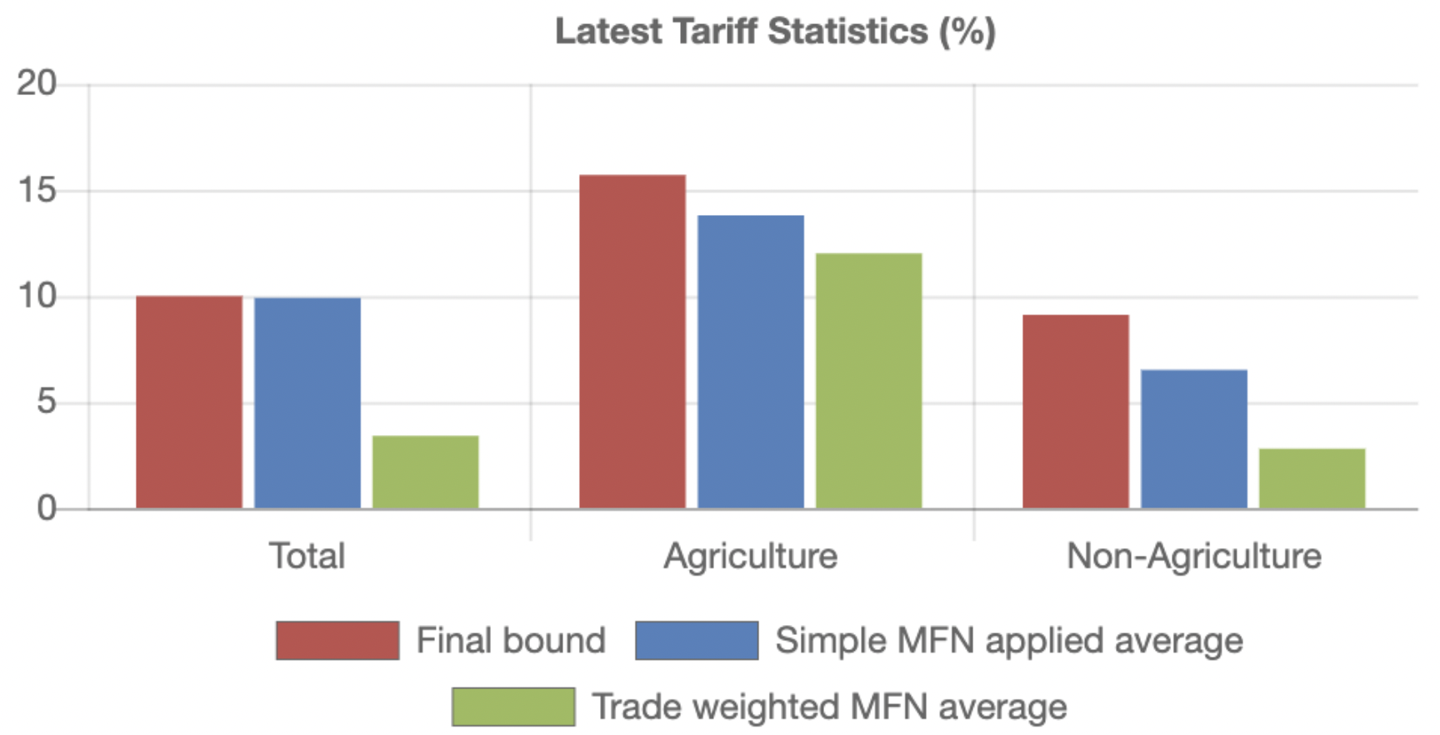
China Tariffs per WTO
Notes:
https://www.wto.org/english/thewto_e/countries_e/china_e.htm

Slide 44
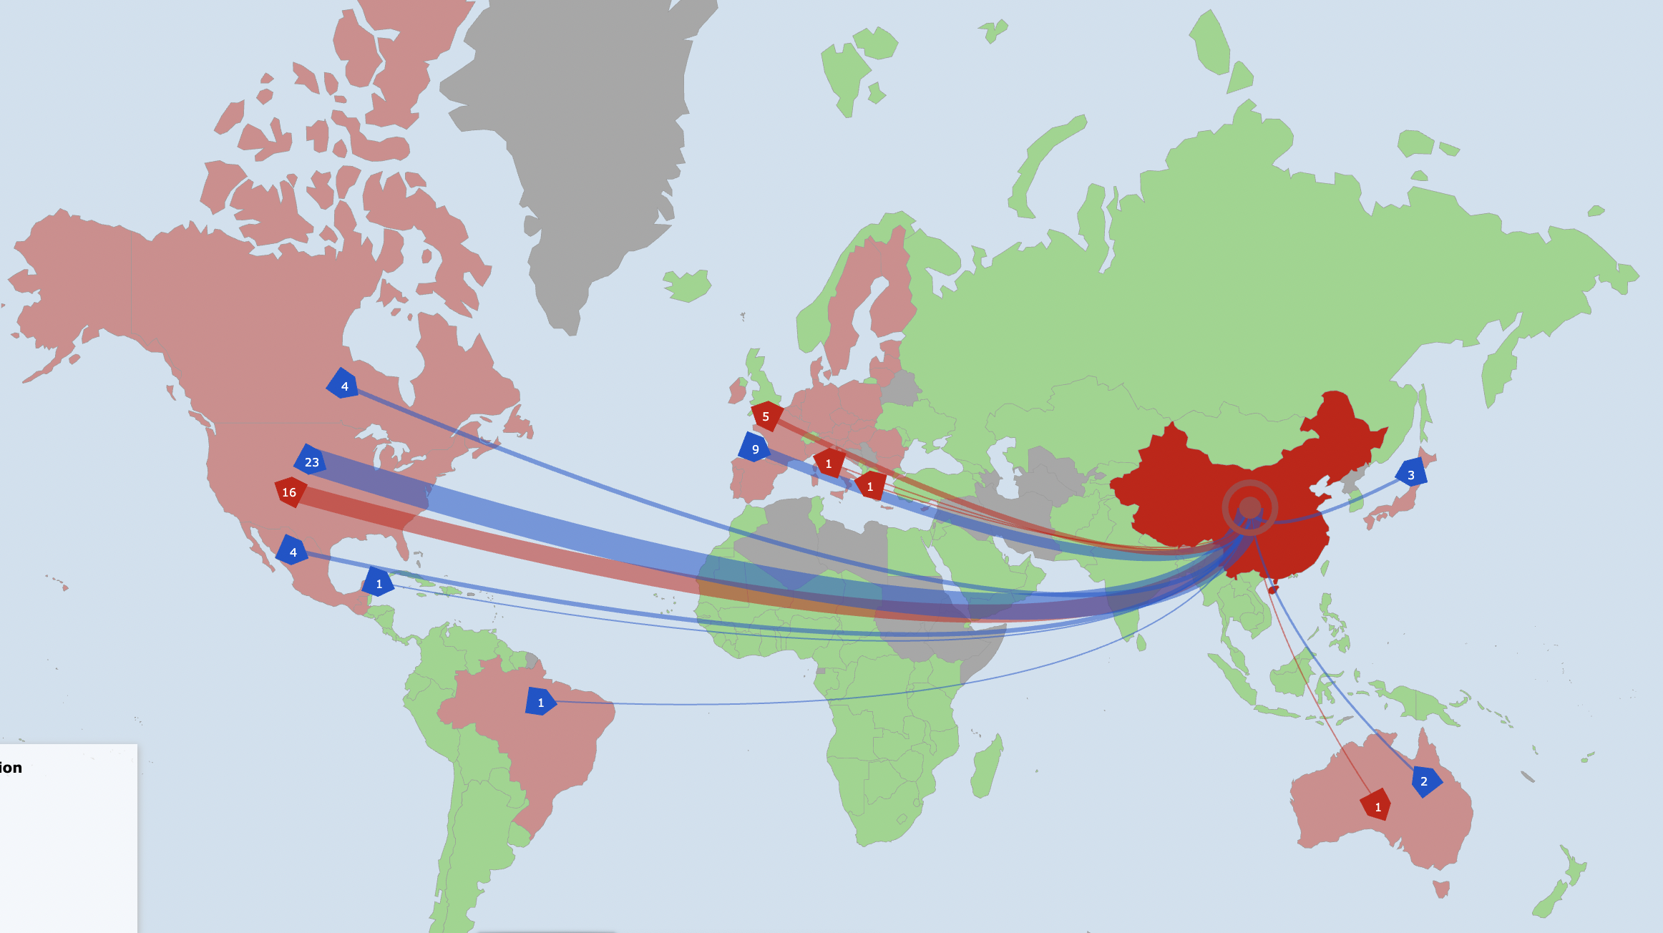
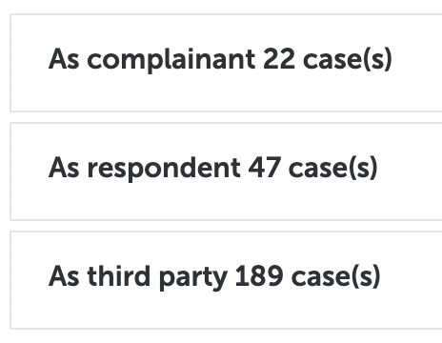
Disputes Involving China per WTO
Notes:
https://www.wto.org/english/tratop_e/dispu_e/dispu_maps_iframe_e.htm?country_selected=CHN&sense=e

Slide 45
China
Disputes at WTO in 2020-21: Respondent Complainant
  DS603: Australia — Anti-Dumping and Countervailing Duty Measures on Certain Products from China
    In consultations on 24 June 2021
  DS602: China — Anti-Dumping and Countervailing Duty Measures on Wine from Australia
    In consultations on 22 June 2021
  DS601: China — Anti-Dumping measures on stainless steel products from Japan
    In consultations on 11 June 2021
  DS597: United States — Origin Marking Requirement (from Hong Kong, China)
    Panel composed on 29 April 2021
Notes:
Gabel, Matthew J., “European Union,” Encyclopedia Britanica, 2020.
https://www.britannica.com/topic/European-Union/The-Maastricht-Treaty

Slide 46
Pause for Discussion

Slide 47
  Questions on China’s
  “Trade Policy Review 2018”
How had (as of this 2018 report) China’s GDP growth rate changed? How had its current account surplus changed?
Did the government intend to eliminate State Owned Enterprises?
How, if at all, does China manage inward foreign direct investment?
Does China require technology transfer by foreign investors?

Slide 48
  Questions on “Trade Policy Review 2018” continued
How high are China’s tariffs?
What is China’s policy regarding trade in garbage (solid waste)?
What other forms of trade policy does China have besides tariffs?

Slide 49
Outline
European Union
Japan
China
Other

Slide 50

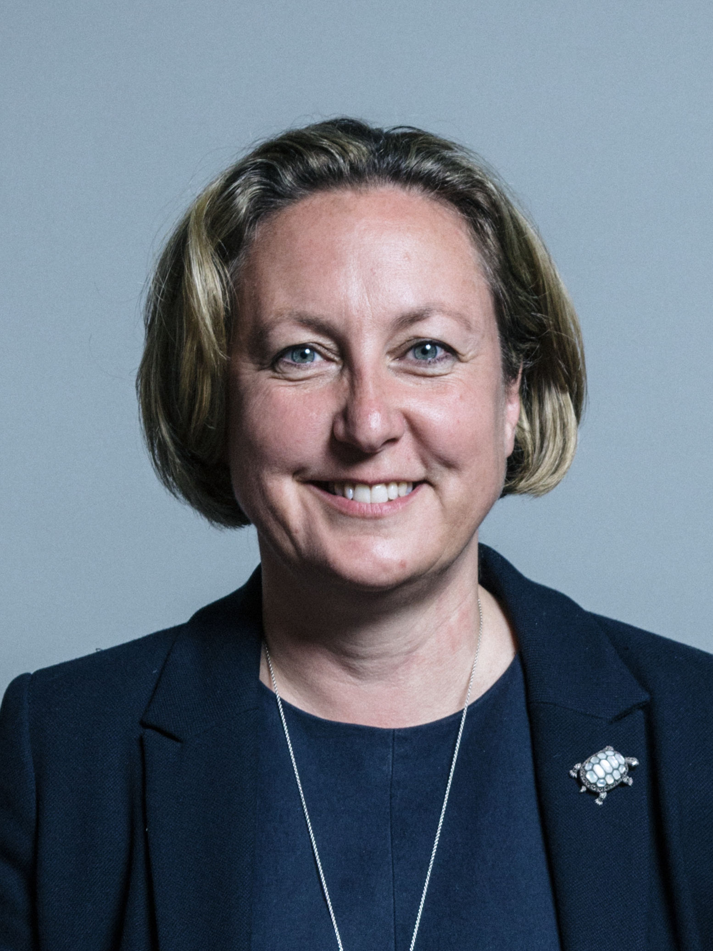
Other
United Kingdom
  Department for International Trade
    Minister of State for Trade: Penny Mordaunt since September 2021
    Trade Secretary: Anne-Marie Trevelyan since September 2021
      “Secretary of State for International Trade”
  UK Trade Remedies Authority
    Handles AD, CVD, and Safeguards

Slide 51

Other
Australia
  Minister for Trade, Tourism and Investment
    Senator the Hon Dan Tehan since 2020
  Anti-Dumping Commission
    Handles ADD & CVD

Slide 52
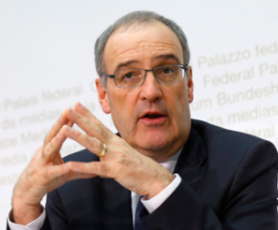
Other
Switzerland
  Federal Department of Economic Affairs, Education and Research
    Headed by Guy Parmelin since 2019
    (Now also President)
  Does not use ADD, CVD, safeguards, or quotas
  Has many FTAs, including with EU

Slide 53


Other
South Korea
  Ministry of Trade, Industry, and Energy
    Minister: Moon Sung Wook
      Since May 2021
    Minister for Trade: Yeo Han-koo
      Since August 2021

Slide 54
Other
Trade Ministers:
  Afghanistan: Ministry of Commerce and Industry, Anwar-Ul-Haq Ahady 2010-21
  Argentina: Ministry of Productive Development, Matías Kulfas since 10 Dec 2019
  Indonesia: Ministry of Trade, Muhammad Lutfi since 2020
  Dominican Republic: Minister of Foreign Affairs, Roberto Álvarez Gil

